Slide 1

Introduction to Chapel Parallel Programming Language
Michelle Strout and Jeremiah Corrado
CUF23: Sponsored by OLCF, NERSC, and ECP
July 26-27, 2023

Slide 2
Introduction to Chapel
What Chapel is and how programmers are using Chapel in their applications
Chapel execution model with a parallel and distributed "Hello World"
2D Heat Diffusion example: variants and how to compile and run them
Learning objectives for today's 90-minute Chapel tutorial

Slide 3
Chapel Programming Language
Chapel is a general-purpose programming language that provides
ease of parallel programming,
high performance, and
portability.
And is being used in applications in various ways:
refactoring existing codes,
developing new codes,
serving high performance to Python codes (Chapel server with Python client), and
providing distributed and shared memory parallelism for existing codes.
Notes:
providing distributed and shared memory parallelism for existing codes is for HPO, which doesn't show up later in this talk, but I am going to keep in the reference anyway

Slide 4
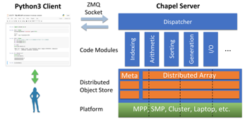
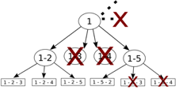
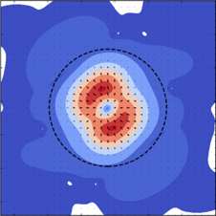
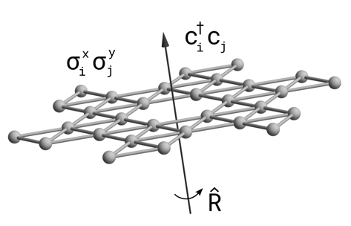
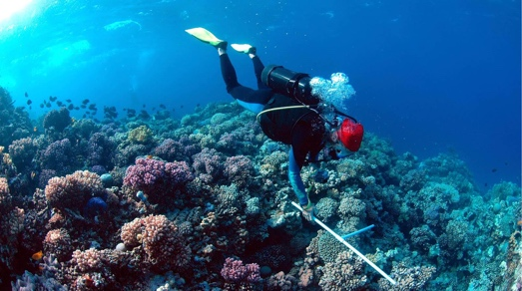

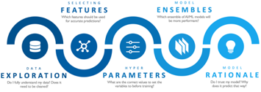
Applications of Chapel: Links to Users’ Talks (slides + Video)
CHAMPS: 3D Unstructured CFD
Laurendeau, Bourgault-Côté, Parenteau, Plante, et al.
École Polytechnique Montréal
Arkouda: Interactive Data Science at Massive Scale
Mike Merrill, Bill Reus, et al.
U.S. DoD
ChOp: Chapel-based Optimization
T. Carneiro, G. Helbecque, N. Melab, et al.
INRIA, IMEC, et al.
ChplUltra: Simulating Ultralight Dark Matter
Nikhil Padmanabhan, J. Luna Zagorac, et al.
Yale University et al.
CHIUW 2021
CHIUW 2022
CHIUW 2020
CHIUW 2023
CHIUW 2021
CHIUW 2023
CHIUW 2020
CHIUW 2022
Lattice-Symmetries: a Quantum Many-Body Toolbox
Tom Westerhout
Radboud University
Desk dot chpl: Utilities for Environmental Eng.
Nelson Luis Dias
The Federal University of Paraná, Brazil
RapidQ: Mapping Coral Biodiversity
Rebecca Green, Helen Fox, Scott Bachman, et al.
The Coral Reef Alliance
ChapQG: Layered Quasigeostrophic CFD
Ian Grooms and Scott Bachman
University of Colorado, Boulder et al.
CHIUW 2022
CHIUW 2022
CHIUW 2023
?
Chapel-based Hydrological Model Calibration Marjan Asgari et al.
University of Guelph
CrayAI HyperParameter Optimization (HPO)
Ben Albrecht et al.
Cray Inc. / HPE
CHGL: Chapel Hypergraph Library
Louis Jenkins, Cliff Joslyn, Jesun Firoz, et al.
PNNL
Your Application Here?
CHIUW 2023
CHIUW 2021
CHIUW 2020
(images provided by their respective teams and used with permission)
⁴
Notes:
Copied from Brad's ChapelForPASC2023 presentation.
quite a few applications being used in production have been written in Chapel. Chapel programmers often express how the risk of using a less well-known language was well worth the acceleration in productivity and quick route to performance and scalability.

Slide 5

Highlights of Chapel Usage
CHAMPS: Computational Fluid Dynamics framework for airplane simulation
Professor Eric Laurendeau’s team at Polytechnique Montreal
Performance: achieves competitive results w.r.t. established, world-class frameworks from Stanford, MIT, etc.
Programmability: "We ask students at the master's degree to do stuff that would take 2 years and they do it in 3 months."
Arkouda: data analytics framework (https://github.com/Bears-R-Us/arkouda)
Mike Merrill, Bill Reus, et al., US DOD
Python front end client, Chapel server that processes dozens of terabytes in seconds
April 2023: 1200 GiB/s for argsort on an HPE EX system
Recent Journal Paper on using Chapel for calibrating hydrologic models
Marjan Asgari et al, "Development of a knowledge-sharing parallel computing approach for calibrating distributed watershed hydrologic models", Environmental Modeling and Software.
They report super-linear speedup
Notes:
CHAMPS participating in 4th CFD High Lift Prediction Workshop and 1st Icing Prediction Workshop
Rest of quote: And I'm not joking, this is from 2 years to 3 months. So if you want to take a summer internship and you say 'program a new turbulance model', well they manage. And before, it was impossible to do

Slide 6
Arkouda Argsort Performance
HPE Apollo (May 2021)
HDR-100 Infiniband network (100 Gb/s)
576 compute nodes
72 TiB of 8-byte values
~480 GiB/s (~150 seconds)
HPE Cray EX (April 2023)
Slingshot-11 network (200 Gb/s)
896 compute nodes
28 TiB of 8-byte values
~1200 GiB/s (~24 seconds)
HPE Cray EX (May 2023)
Slingshot-11 network (200 Gb/s)
8192 compute nodes
256 TiB of 8-byte values
~8500 GiB/s (~31 seconds)
A notable performance achievement in ~100 lines of Chapel
better
Notes:
Brad 2023 PASC talk.

Slide 7
Chapel Execution Model and Terminology: Locales
Locales can run tasks and store variables
Each locale executes on a “compute node” on a parallel system
User specifies number of locales on executable’s command-line
prompt> ./myChapelProgram --numLocales=4 # or ‘–nl 4’
Four nodes/CPUs
locale 0
locale 1
locale 2
locale 3
Locales array:
User’s code starts running as a single task on locale 0
Notes:
With Chapel don't have to think about other copies of the program, unlike in SPMD.

Slide 8
Task-Parallel “Hello world”
hello-dist-node-names.chpl
const numTasks = here.numPUs();
coforall tid in 1..numTasks do
writef("Hello from task %n of %n on %s\n",
tid, numTasks, here.name);
Notes:
FIXME: change to writeln

Slide 9
Task-Parallel “Hello world”
hello-dist-node-names.chpl
‘here’ refers to the locale on which we’re currently running
const numTasks = here.numPUs();
coforall tid in 1..numTasks do
writef("Hello from task %n of %n on %s\n",
tid, numTasks, here.name);
how many processing units (think “cores”) does my locale have?
what’s my locale’s name?
Notes:
FIXME: change to writeln

Slide 10
Task-Parallel “Hello world”
hello-dist-node-names.chpl
const numTasks = here.numPUs();
coforall tid in 1..numTasks do
writef("Hello from task %n of %n on %s\n",
tid, numTasks, here.name);
a 'coforall’ loop executes each iteration as an independent task
> chpl hello-dist-node-names.chpl
> ./hello-dist-node-names
Hello from task 1 of 4 on n1032
Hello from task 4 of 4 on n1032
Hello from task 3 of 4 on n1032
Hello from task 2 of 4 on n1032
Notes:
FIXME: change to writeln

Slide 11
Task-Parallel “Hello world”
hello-dist-node-names.chpl
const numTasks = here.numPUs();
coforall tid in 1..numTasks do
writef("Hello from task %n of %n on %s\n",
tid, numTasks, here.name);
> chpl hello-dist-node-names.chpl
> ./hello-dist-node-names
Hello from task 1 of 4 on n1032
Hello from task 4 of 4 on n1032
Hello from task 3 of 4 on n1032
Hello from task 2 of 4 on n1032
So far, this is a shared-memory program
Nothing refers to remote locales, explicitly or implicitly
Notes:
FIXME: change to writeln

Slide 12
Task-Parallel “Hello world” (Distributed version)
hello-dist-node-names.chpl
coforall loc in Locales {
on loc {
const numTasks = here.maxTaskPar;
coforall tid in 1..numTasks do
writef("Hello from task %n of %n on %s\n",
tid, numTasks, here.name);
}
}
the array of locales we’re running on (introduced a few slides back)
Locale 0
Locale 1
Locale 2
Locale 3
Locales array:

Slide 13
Task-Parallel “Hello world” (Distributed version)
hello-dist-node-names.chpl
create a task per locale on which the program is running
coforall loc in Locales {
on loc {
const numTasks = here.numPUs();
coforall tid in 1..numTasks do
writef("Hello from task %n of %n on %s\n",
tid, numTasks, here.name);
}
}
have each task run ‘on’ its locale
then print a message per core, as before
> chpl hello-dist-node-names.chpl
> ./hello-dist-node-names -nl=4
Hello from task 1 of 4 on n1032
Hello from task 4 of 4 on n1032
Hello from task 1 of 4 on n1034
Hello from task 2 of 4 on n1032
Hello from task 1 of 4 on n1033
Hello from task 3 of 4 on n1034
Hello from task 1 of 4 on n1035
…
Notes:
FIXME: change to writeln

Slide 14
2D Heat Diffusion Example
See https://github.com/mstrout/CUF23-OLCF-Tutorial for more info and for example code.
See 'diffusion/heat_2D.*.chpl' in the Chapel examples
'heat_2D.chpl' - shared memory parallel version that runs in locale 0
'heat_2D_dist.chpl' - parallel and distributed version that is the same as 'heat_2D.chpl' but with distributed arrays
'heat_2D_dist_buffers.chpl' - parallel and distributed version that copies to neighbors landing pad and then into local halos
Some things to try out with these variants
chpl heat_2D.chpl
./heat_2D -nl 1
--nt 10 --nx=2048 --ny=2048 # increases the number of time steps
# and reduces the size of the domain
# along each dimension from default 4096
Notes:
FIXME
* need to check these options all work
* probably are going to need more slides about this example preferrrably some with diagrams in the programming in Chapel section
* want at least one diagram slide here as well

Slide 15
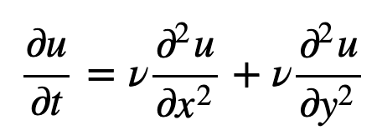
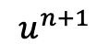
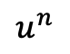
Parallel Heat Diffusion in Heat_2D.chpl
2D heat diffusion PDE
Solving for next temperatures at each time step using finite difference method
All updates in a timestep can be done in parallel
Output is the average and standard of all the values and time to solution
$$u_{i,j}^{n+1}=u_{i,j}^{n}+α\left(u_{i+1,j}^{n}+u_{i−1,j}^{n}−4u_{i,j}^{n}+u_{i,j+1}^{n}+u_{i,j−1}^{n}\right)$$
$$u^{n}$$
$$u^{n+1}$$
Stored in un
Stored in u
Fixed boundary values

Slide 16
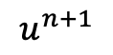
Distributed and Parallel Heat Diffusion in Heat_2D_DIST.chpl
'u' and 'un' arrays are distributed (2x2 distribution is shown)
Reads that cross the distribution boundary will result in a remote get
$$u^{n}$$
$$u^{n+1}$$
Stored in un
Stored in u

Slide 17
Parallelism Supported By Chapel
Synchronous parallellism
'coforall', distributed memory parallelism across processes/locales with 'on' syntax
'coforall', shared-memory parallelism over threads
'cobegin', executes all statements in block in parallel
Asynchronous parallelism
'begin', creates an asynchronous task
'sync' and 'atomic' vars for task coordination
spawning subprocesses
Higher-level parallelism abstractions
'forall', data parallelism and iterator abstraction
'foreach', SIMD parallelism
'scan', operations such as cumulative sums
'reduce', operations such as summation
iteration
coforall
iteration
iteration
stmt
begin
begin
begin
stmt
stmt
Notes:
educe-scan-operator: one of + * && || & | ^ 'min' 'max' 'minmax' 'minloc' 'maxloc'

Slide 18
Learning Objectives For Today's Chapel Tutorial
Compile and run Chapel programs
Familiarity with the Chapel execution model including how to run codes in parallel on a single node, across nodes, and both
Learn Chapel concepts by compiling and running provided code examples
Serial code using map/dictionary, (k-mer counting from bioinformatics)
Parallelism and locality in Chapel
Distributed parallelism and 1D arrays, (processing files in parallel)
Distributed parallelism and 2D arrays, (heat diffusion problem will see in UPC++ and CAF)
Distributed parallel image processing, (coral reef diversity example)
GPU parallelism (stream example)
Where to get help and how you can participate in the Chapel community
Notes:
Multi-GPU stream example on crusher, https://github.com/Cray/chapel-private/issues/4615
FIXME: try to align with CUF outline

Slide 19
Programing in Chapel
Michelle Strout and Jeremiah Corrado
CUF23: Sponsored by OLCF, NERSC, and ECP
July 26-27, 2023

Slide 20
Learning Objectives For Today's Chapel Tutorial
Compile and run Chapel programs
Familiarity with the Chapel execution model including how to run codes in parallel on a single node, across nodes, and both
Learn Chapel concepts by compiling and running provided code examples
Serial code using map/dictionary, (k-mer counting from bioinformatics)
Parallelism and locality in Chapel
Distributed parallelism and 1D arrays, (processing files in parallel)
Distributed parallelism and 2D arrays, (heat diffusion problem will see in UPC++ and CAF)
Distributed parallel image processing, (coral reef diversity example)
GPU parallelism (stream example)
Where to get help and how you can participate in the Chapel community
Notes:
Multi-GPU stream example on crusher, https://github.com/Cray/chapel-private/issues/4615
FIXME: try to align with CUF outline

Slide 21

How to Participate in this Tutorial And Afterwards
During the tutorial today and tomorrow (July 26-27, 2023)
Download the tarball of examples and follow the instructions in the README
wget https://go.lbl.gov/cuf23.tar.gz
tar xzf cuf23.tar.gz
cd cuf23/
After the tutorial
The cuf23 tarball will still be available or clone from https://github.com/mstrout/CUF23-OLCF-Tutorial for Chapel code
Attempt this Online website for running Chapel code
Go to main Chapel webpage at https://chapel-lang.org/ and click on the ATO icon on the lower left
Using a container on your laptop
First, install docker for your machine and then start it up
Then, the below commands work with docker
docker pull docker.io/chapel/chapel-gasnet # takes about 5 minutes
docker run --rm -v "$PWD":/myapp -w /myapp chapel/chapel-gasnet chpl hello.chpl
docker run --rm -v "$PWD":/myapp -w /myapp chapel/chapel-gasnet ./hello -nl 1
Notes:
FIXME: double check the docker instructions

Slide 22
SERIAL CODE Using Map/Dictionary: K-mer Counting
kmer.chpl
‘Map’ and 'IO' are two of the standard libraries provided in Chapel. A 'map' is like a dictionary in python.
use Map, IO;
config const infilename = ("kmer_large_input.txt");
config const k = 4;
var sequence, line : string;
var f = open(infilename, ioMode.r);
var infile = f.reader();
while infile.readLine(line) {
sequence += line.strip();
}
infile.close();
var nkmerCounts : map(string, int);
for ind in 0..<(sequence.size-k) {
nkmerCounts[sequence[ind..#k]] += 1;
}
'config const' indicates a configuration constant, which result in built-in command-line parsing
Reading all of the lines from the input file into the string 'sequence'.
The variable 'nkmerCounts' is being declared as a dictionary mapping strings to ints
Counting up each kmer in the sequence
Notes:
Talk about the code and have them run it.
Concepts
* config consts
* reading lines from a file
* using a Map to do histogramming
* no parallelism

Slide 23
Experimenting with the k-mer Example
make run-kmer
See https://github.com/mstrout/CUF23-OLCF-Tutorial for more info and for example code.
Some things to try out with 'kmer.chpl'
chpl kmer.chpl
./kmer -nl 1
./kmer -nl 1 –-k=10 # can change k
./kmer -nl 1 --infilename="kmer.chpl" # changing infilename
./kmer -nl 1 --k=10 --infilename="kmer.chpl" # can change both
Key concepts
'use' command for including modules
configuration constants, 'config const'
reading from a file
'map' data structure

Slide 24
Learning Objectives For Today's Chapel Tutorial
Compile and run Chapel programs
Familiarity with the Chapel execution model including how to run codes in parallel on a single node, across nodes, and both
Learn Chapel concepts by compiling and running provided code examples
Serial code using map/dictionary, (k-mer counting from bioinformatics)
Parallelism and locality in Chapel
Distributed parallelism and 1D arrays, (processing files in parallel)
Distributed parallelism and 2D arrays, (heat diffusion problem will see in UPC++ and CAF)
Distributed parallel image processing, (coral reef diversity example)
GPU parallelism (stream example)
Where to get help and how you can participate in the Chapel community
Notes:
Multi-GPU stream example on crusher, https://github.com/Cray/chapel-private/issues/4615
FIXME: try to align with CUF outline

Slide 25
Parallelism Supported By Chapel
Synchronous parallellism
'coforall', distributed memory parallelism across processes/locales with 'on' syntax
'coforall', shared-memory parallelism over threads
'cobegin', executes all statements in block in parallel
Asynchronous parallelism
'begin', creates an asynchronous task
'sync' and 'atomic' vars for task coordination
spawning subprocesses
Higher-level parallelism abstractions
'forall', data parallelism and iterator abstraction
'foreach', SIMD parallelism
'scan', operations such as cumulative sums
'reduce', operations such as summation
iteration
coforall
iteration
iteration
stmt
begin
begin
begin
stmt
stmt
Notes:
educe-scan-operator: one of + * && || & | ^ 'min' 'max' 'minmax' 'minloc' 'maxloc'

Slide 26
Applications of Chapel: Links to Users’ Talks (slides + Video)
CHAMPS: 3D Unstructured CFD
Laurendeau, Bourgault-Côté, Parenteau, Plante, et al.
École Polytechnique Montréal
Arkouda: Interactive Data Science at Massive Scale
Mike Merrill, Bill Reus, et al.
U.S. DoD
ChOp: Chapel-based Optimization
T. Carneiro, G. Helbecque, N. Melab, et al.
INRIA, IMEC, et al.
ChplUltra: Simulating Ultralight Dark Matter
Nikhil Padmanabhan, J. Luna Zagorac, et al.
Yale University et al.
CHIUW 2021
CHIUW 2022
CHIUW 2020
CHIUW 2023
CHIUW 2021
CHIUW 2023
CHIUW 2020
CHIUW 2022
Lattice-Symmetries: a Quantum Many-Body Toolbox
Tom Westerhout
Radboud University
Desk dot chpl: Utilities for Environmental Eng.
Nelson Luis Dias
The Federal University of Paraná, Brazil
RapidQ: Mapping Coral Biodiversity
Rebecca Green, Helen Fox, Scott Bachman, et al.
The Coral Reef Alliance
ChapQG: Layered Quasigeostrophic CFD
Ian Grooms and Scott Bachman
University of Colorado, Boulder et al.
CHIUW 2022
CHIUW 2022
CHIUW 2023
?
Chapel-based Hydrological Model Calibration Marjan Asgari et al.
University of Guelph
CrayAI HyperParameter Optimization (HPO)
Ben Albrecht et al.
Cray Inc. / HPE
CHGL: Chapel Hypergraph Library
Louis Jenkins, Cliff Joslyn, Jesun Firoz, et al.
PNNL
Your Application Here?
CHIUW 2023
CHIUW 2021
CHIUW 2020
(images provided by their respective teams and used with permission)
²⁶
Notes:
Copied from Brad's ChapelForPASC2023 presentation.

Slide 27
Use of Tasks in Some Applications and Benchmarks
Application | Distributed 'coforall' | Threaded 'coforall' | Asynchronous 'begin' | 'cobegin' | sync or atomic vars | subprocesses | forall | scan
Hello World | ✔︎ | ✔︎
HPO | ✔︎ | ✔︎ |  |  |  | ✔
Arkouda | ✔︎ | ✔︎ |  |  |  |  | ✔ | ✔
CHAMPS | ✔︎ | ✔︎
ChOp | ✔︎ |  | ✔ |  | ✔︎ |  | ✔︎
ParFlow |  |  |  |  |  |  | ✔
Coral Reef | ✔︎ | ✔︎ |  | ✔ |  |  | ✔
Task Graph |  |  | ✔︎ |  | ✔︎

Slide 28
Parallelism Across Locales and Within Locales
make run-hellopar
// can be set on the command line with --tasksPerLocale=2
config const tasksPerLocale = 1;
// parallel loops over nodes and then over threads
coforall loc in Locales do on loc {
coforall tid in 0..#tasksPerLocale {
writeln("Hello world! ",
"(from task ", tid,
" of ", tasksPerLocale,
" on locale ", here.id,
" of ", numLocales, ")" );
}
}
Parallel hello world
hellopar.chpl
Key concepts
'coforall' over the `Locales` array with an `on` statement
'coforall' creating some number of tasks per locale
configuration constants, 'config const'
range values, '0..#tasksPerLocale'
'writeln'
inline comments start with '//'

Slide 29
Locales and Execution Model in Chapel
In Chapel, a locale refers to a compute resource with…
processors, so it can run tasks
memory, so it can store variables
For now, think of each compute node as having one locale run on it
Compute Node 0
Compute Node 1
Compute Node 2
Compute Node 3
Processor Core
Memory
Notes:
This sequence of slides is from ChapelForCTOTechSeries in 2023 from Brad.

Slide 30
Locales and Execution Model in Chapel
Two key built-in variables for referring to locales in Chapel programs:
Locales: An array of locale values representing the system resources on which the program is running
here: The locale on which the current task is executing
Locale 0
Locale 1
Locale 2
Locale 3
Processor Core
Memory

Slide 31

Key Concerns for scalable Parallel Computing
parallelism: What tasks should run simultaneously?
locality: Where should tasks run? Where should data be allocated?
Locale 0
Locale 1
Locale 2
Locale 3
Processor Core
Memory

Slide 32
Basic Features for Locality
basics-on.chpl
All Chapel programs begin running as a single task on locale 0
writeln("Hello from locale ", here.id);
var A: [1..2, 1..2] real;
on Locales[1] {
var B: [1..2, 1..2] real;
B = 2 * A;
}
Variables are stored using the memory local to the current task
on-clauses move tasks to other locales
remote variables can be accessed directly
This is a serial, but distributed computation
Locale 0
Locale 1
Locale 2
Locale 3

Slide 33
Basic Features for Locality
basics-for.chpl
writeln("Hello from locale ", here.id);
var A: [1..2, 1..2] real;
for loc in Locales {
on loc {
var B = A;
}
}
This loop will serially iterate over the program’s locales
This is also a serial, but distributed computation
Locale 0
Locale 1
Locale 2
Locale 3

Slide 34
Mixing Locality with Task Parallelism
basics-coforall.chpl
writeln("Hello from locale ", here.id);
var A: [1..2, 1..2] real;
coforall loc in Locales {
on loc {
var B = A;
}
}
The coforall loop creates a parallel task per iteration
This results in a parallel distributed computation
Locale 0
Locale 1
Locale 2
Locale 3

Slide 35
Array-based Parallelism and locality
basics-distarr.chpl
writeln("Hello from locale ", here.id);
var A: [1..2, 1..2] real;
use BlockDist;
var D = Block.createDomain({1..2, 1..2});
var B: [D] real;
B = A;
Chapel also supports distributed domains (index sets) and arrays
They also result in parallel distributed computation
Locale 0
Locale 1
Locale 2
Locale 3

Slide 36
Parallelism Across Locales and Within Locales
make run-hellopar
// can be set on the command line with --tasksPerLocale=2
config const tasksPerLocale = 1;
// parallel loops over nodes and then over threads
coforall loc in Locales do on loc {
coforall tid in 0..#tasksPerLocale {
writeln("Hello world! ",
"(from task ", tid,
" of ", tasksPerLocale,
" on locale ", here.id,
" of ", numLocales, ")" );
}
}
Parallel hello world
hellopar.chpl
Key concepts
'coforall' over the `Locales` array with an `on` statement
'coforall' creating some number of tasks per locale
configuration constants, 'config const'
range values, '0..#tasksPerLocale'
'writeln'
inline comments start with '//'
Things to try
./run-hellopar -nl 1 --tasksPerLocale=3
./run-hellopar -nl 2 --tasksPerLocale=3

Slide 37
Parallelism and locality are orthogonal in Chapel
This is a parallel, but local program:
This is a distributed, but serial program:
This is a distributed parallel program:
coforall i in 1..msgs do
writeln("Hello from task ", i);
writeln("Hello from locale 0!");
on Locales[1] do writeln("Hello from locale 1!");
on Locales[2] {
writeln("Hello from locale 2!");
on Locales[0] do writeln("Hello from locale 0!"); } writeln("Back on locale 0");
coforall i in 1..msgs do
on Locales[i%numLocales] do
writeln("Hello from task ", i, " running on locale ", here.id);
Notes:
From bradc/ChapelForOokamiUsers talk

Slide 38
Learning Objectives For Today's Chapel Tutorial
Compile and run Chapel programs
Familiarity with the Chapel execution model including how to run codes in parallel on a single node, across nodes, and both
Learn Chapel concepts by compiling and running provided code examples
Serial code using map/dictionary, (k-mer counting from bioinformatics)
Parallelism and locality in Chapel
Distributed parallelism and 1D arrays, (processing files in parallel)
Distributed parallelism and 2D arrays, (heat diffusion problem will see in UPC++ and CAF)
Distributed parallel image processing, (coral reef diversity example)
GPU parallelism (stream example)
Where to get help and how you can participate in the Chapel community
Notes:
Multi-GPU stream example on crusher, https://github.com/Cray/chapel-private/issues/4615
FIXME: try to align with CUF outline

Slide 39
Processing Files in Parallel
make run-parfilekmer
See 'parfilekmer.chpl' in the repository
Some things to try out with 'parfilekmer.chpl'
# put more and bigger files into DataDir/
# or set the config const dir to something else
chpl parfilekmer.chpl --fast
./parfilekmer -nl 2 --dir="SomethingElse/"
./parfilekmer -nl 2 –-k=10 # can also change k

Slide 40
Analyzing Multiple Files Using PArallelism
parfilekmer.chpl
prompt> chpl --fast parfilekmer.chpl
prompt> ./parfilekmer -nl 1
prompt> ./parfilekmer –nl 4
use FileSystem;
config const dir = “DataDir”;
var fList = findFiles(dir);
var filenames =
Block.createArray(0..#fList.size,string);
filenames = fList;
// per file word count
forall f in filenames {
...
// code from kmer.chpl
...
}
Shared and Distributed-Memory Parallelism using forall, a distributed array, and command line options to indicate number of locales
Notes:
LEFTOFF testing codes here
Concepts
* block distribution of an array of strings
* forall is using the default iterator on filenames, which has been block distributed

Slide 41
Block distribution of Array of Strings
Locale 0
Locale 1
"filename1" | "filename2" | "filename3" | "filename4" | "filename5" | "filename6" | "filename7" | "filename8"
Array of strings for filenames is distributed across locales
'forall' will do parallelism across locales and then within each locale to take advantage of multicore

Slide 42
Processing Files in Parallel
make run-parfilekmer
See 'parfilekmer.chpl' in the repository
Some things to try out with 'parfilekmer.chpl'
# put more and bigger files into DataDir/
# or set the config const dir to something else
chpl parfilekmer.chpl --fast
./parfilekmer -nl 2 --dir="SomethingElse/"
./parfilekmer -nl 2 –-k=10 # can also change k
Concepts illustrated
'forall' provides distributed and shared memory parallelism when do a 'forall' over the Block distributed array
No puts and gets happening yet

Slide 43
Learning Objectives For Today's Chapel Tutorial
Compile and run Chapel programs
Familiarity with the Chapel execution model including how to run codes in parallel on a single node, across nodes, and both
Learn Chapel concepts by compiling and running provided code examples
Serial code using map/dictionary, (k-mer counting from bioinformatics)
Parallelism and locality in Chapel
Distributed parallelism and 1D arrays, (processing files in parallel)
Distributed parallelism and 2D arrays, (heat diffusion problem will see in UPC++ and CAF)
Distributed parallel image processing, (coral reef diversity example)
GPU parallelism (stream example)
Where to get help and how you can participate in the Chapel community
Notes:
Multi-GPU stream example on crusher, https://github.com/Cray/chapel-private/issues/4615
FIXME: try to align with CUF outline

Slide 44
Chapel Supports a Global Namespace with Puts and Gets
Note 1: Variables are allocated on the locale where the task is running
onClause.chpl
verbose
total
done
locale 0
config const verbose = false;
var total = 0,
done = false;
…
on Locales[1] {
var x, y, z: int;
…
}
false
0
false
x
y
z
locale 1
0
0
0
44
Notes:
This 9-slide sequence is copied from Brad's ChapelForSHMEMDevs talk.

Slide 45
Chapel Supports a Global Namespace
Note 2: Tasks can refer to lexically visible variables, whether local or remote
onClause.chpl
verbose
total
done
locale 0
config const verbose = false;
var total = 0,
done = false;
…
on Locales[1] {
if !done {
if verbose then
writef("Adding locale 1’s contribution");
total += computeMyContribution();
}
}
false
0
false
code runs on locale 1, but refers to values stored on locale 0
locale 1
if !done {
if verbose then
writef("Adding…
total += computi…
}
45

Slide 46
Capturing variables for on-clauses
onClause.chpl
verbose
total
done
locale 0
config const verbose = false;
var total = 0,
done = false;
…
on Locales[1] {
if !done {
if verbose then
writef("Adding locale 1’s contribution");
total += computeMyContribution();
}
}
false
0
false
locale 1

Slide 47
Capturing variables for on-clauses
onClause.chpl
verbose
total
done
locale 0
config const verbose = false;
var total = 0,
done = false;
…
on Locales[1] {
if !done {
if verbose then
writef("Adding locale 1’s contribution");
total += computeMyContribution();
}
}
false
0
false
Which outer-scope variables are referenced?
done
verbose
total
argument bundle
locale 1

Slide 48
Capturing variables for on-clauses
onClause.chpl
verbose
total
done
locale 0
config const verbose = false;
var total = 0,
done = false;
…
on Locales[1] {
if !done {
if verbose then
writef("Adding locale 1’s contribution");
total += computeMyContribution();
}
}
false
0
false
Which outer-scope variables are referenced?
done
verbose
total
argument bundle
locale 1
false
Which are constant? Can capture these by value.

Slide 49
Capturing variables for on-clauses
onClause.chpl
verbose
total
done
locale 0
config const verbose = false;
var total = 0,
done = false;
…
on Locales[1] {
if !done {
if verbose then
writef("Adding locale 1’s contribution");
total += computeMyContribution();
}
}
false
0
false
Which outer-scope variables are referenced?
done
verbose
total
argument bundle
false
locale 1
false
Which are constant? Can capture these by value.
Which are MCM-safe to cache? Can capture these by value.
MCM = Memory Consistency Model | R[D]MA = Remote [Direct] Memory Access

Slide 50
Capturing variables for on-clauses
onClause.chpl
verbose
total
done
locale 0
config const verbose = false;
var total = 0,
done = false;
…
on Locales[1] {
if !done {
if verbose then
writef("Adding locale 1’s contribution");
total += computeMyContribution();
}
}
false
0
false
Which outer-scope variables are referenced?
done
verbose
total
argument bundle
false
locale 1
false
Which are constant? Can capture these by value.
Which are MCM-safe to cache? Can capture these by value.
What remains? Have these refer to the original, using R[D]MA to access.
MCM = Memory Consistency Model | R[D]MA = Remote [Direct] Memory Access

Slide 51
Capturing variables for on-clauses
onClause.chpl
verbose
total
done
locale 0
config const verbose = false;
var total = 0,
done = false;
…
on Locales[1] {
if !done {
if verbose then
writef("Adding locale 1’s contribution");
total += computeMyContribution();
}
}
false
0
false
locale 1
done
verbose
total
argument bundle
false
false

Slide 52
referring to captured variables
Note 3: puts and gets implemented with comm layer such as GASNET
onClause.chpl
verbose
total
done
locale 0
…
on Locales[1] {
if !done {
if verbose then
writef("Adding locale 1’s contribution");
total += computeMyContribution();
}
}
false
0
false
proc onTask(argBundle) {
if !argBundle.done {
if argBundle.verbose then
writef("Adding locale 1’s contribution");
const locTotal = get(argBundle.ref_total);
locTotal += computeMyContribution();
put(argBundle.ref_total, locTotal);
}
}
locale 1
done
verbose
total
argument bundle
false
false

Slide 53
2D Heat Diffusion Needs Puts & Gets
cd diffusion
make run-heat_2D
See 'diffusion/heat_2D.*.chpl' in the Chapel examples
'heat_2D.chpl' - shared memory parallel version that runs in locale 0
'heat_2D_dist.chpl' - parallel and distributed version that is the same as 'heat_2D.chpl' but with distributed arrays
'heat_2D_dist_buffers.chpl' - parallel and distributed version that copies to neighbors landing pad and then into local halos
Some things to try out with these variants
chpl heat_2D.chpl --fast
./heat_2D -nl 1
--nt 10 --nx=2048 --ny=2048 # increases the number of time steps
# and reduces the size of the domain
# along each dimension from default 4096
Notes:
FIXME
* need to check these options all work
* probably are going to need more slides about this example preferrrably some with diagrams in the programming in Chapel section
* want at least one diagram slide here as well

Slide 54
Array-based Parallelism and locality
basics-distarr.chpl
writeln("Hello from locale ", here.id);
var A: [1..2, 1..2] real;
use BlockDist;
var D = Block.createDomain({1..2, 1..2});
var B: [D] real;
B = A;
Chapel also supports distributed domains (index sets) and arrays
They also result in parallel distributed computation
Locale 0
Locale 1
Locale 2
Locale 3
Notes:
From slide 123 in SoP that wasn't used.

Slide 55
Parallel Heat Diffusion in Heat_2D.chpl
2D heat diffusion PDE
Solving for next temperatures at each time step using finite difference method
All updates in a timestep can be done in parallel
Output is the average and standard of all the values and time to solution
$$u_{i,j}^{n+1}=u_{i,j}^{n}+α\left(u_{i+1,j}^{n}+u_{i−1,j}^{n}−4u_{i,j}^{n}+u_{i,j+1}^{n}+u_{i,j−1}^{n}\right)$$
$$u^{n}$$
$$u^{n+1}$$
Stored in un
Stored in u
Fixed boundary values

Slide 56
Distributed and Parallel Heat Diffusion in Heat_2D_DIST.chpl
'u' and 'un' arrays are distributed across locales (e.g., 2x2 distribution is shown)
Reads that cross the distribution boundary will result in a remote get
$$u^{n}$$
$$u^{n+1}$$
Stored in un
Stored in u

Slide 57
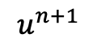
Halo Buffer Optimization in Heat_2D_DIST_Buffers.chpl
Each locale has own copies of 'u' and 'un' subdomains with a one-cell halo
(1) Array assignment writes edge values into neighbors' halo landing pads
(2) copy into local halo
(3) compute next u in parallel locally
$$u^{n}$$
$$u^{n+1}$$
(2) copy into local halo
(1) write to neighbor halo
(3) copy into local halo

Slide 58
Halo Buffer Optimization Code
const indices = {0..<nx, 0..<ny},
indicesInner = indices.expand(-1),
INDICES = Block.createDomain(indices);
const u: [INDICES] real;
...
var LOCALE_DOM = Block.createDomain(u.targetLocales().domain);
var haloArrays: [LOCALE_DOM][0..<4] haloArray;
param N = 0, S = 1, E = 2, W = 3;
...
for 1..nt {
haloArrays[tidX, tidY-1][E].v = uLocal2[.., WW+1];
...
b.barrier();
uLocal1 <=> uLocal2;
uLocal1[.., WW] = haloArrays[tidX, tidY][W].v;
...
forall (i,j) in localIndicesInner do
uLocal2[i,j] = uLocal1[i,j] + alpha*(uLocal1[i-1,j] + uLocal1[i+1,j]
+ uLocal1[i,j-1] + uLocal1[i,j+1] - 4*uLocal1[i,j]);
b.barrier();
}
Declare and distribute 'u' array.
Declare North, South, East, and West halo arrays per locale
Copy local edge results into neighbor's halo array. 'tidX' and 'tidY' are the locale's task id X and Y coordinates.
Copy halo array into local halo.
Compute u[I,j] in local subdomain.
Barrier over all locales
Notes:
From Brad's Ookami users talk. Could consider pointing to code and showing diagrams like this.

Slide 59
2D Heat Diffusion Example
cd diffusion
make run-heat_2D
See 'diffusion/heat_2D.*.chpl' in the Chapel examples
'heat_2D.chpl' - shared memory parallel version that runs in locale 0
'heat_2D_dist.chpl' - parallel and distributed version that is the same as 'heat_2D.chpl' but with distributed arrays
'heat_2D_dist_buffers.chpl' - parallel and distributed version that copies to neighbors landing pad and then into local halos
Concepts illustrated
'forall' provides distributed and shared memory parallelism when do a 'forall' over the 2D Block distributed array
'heat_2D_dist.chpl' version doesn't do any special handling of the halo exchange
'heat_2D_dist_buffers.chpl' shows an optimization that explicitly copies subarrays into buffers
Notes:
FIXME
* need to check these options all work
* probably are going to need more slides about this example preferrrably some with diagrams in the programming in Chapel section
* want at least one diagram slide here as well

Slide 60
Image Processing Example
cd image_analysis
make run-main
See 'image_analysis/' subdirectory in the Chapel examples
Coral reef diversity analysis written by Scott Bachman
Reads a single file in parallel
Uses distributed and shared memory parallelism
Is being used and modified by Scott and collaborators for climate research
'image_analysis/README' explains how to compile and run it
Notes:
I don't think Scott's image analysis is having to insert any puts and gets, but I am not entirely sure, https://github.com/chapel-lang/chapel/blob/main/test/users/bachman/Beta_Diversity
think it has some gets from Locale0
From Ben H, "I think there are two relevant arrays here: the array representing image data, and the "dissimilarity" array.I believe each locale reads into the local image chunk on its own: https://github.com/chapel-lang/chapel/blob/main/test/users/bachman/Beta_Diversity/main.chpl#L168-L189 , so there shouldn't be any GETs there. Furthermore, this section uses IO functionality that starts reading from a particular point in the file.It looks like the code is loading the dissimilarity array on Locale0 and then copying it to each locale before running the computation: https://github.com/chapel-lang/chapel/blob/main/test/users/bachman/Beta_Diversity/main.chpl#L195-L196 , so that would be a source of GETs (should be a bulk-transfer though).After that, I think everything's local."

Slide 61
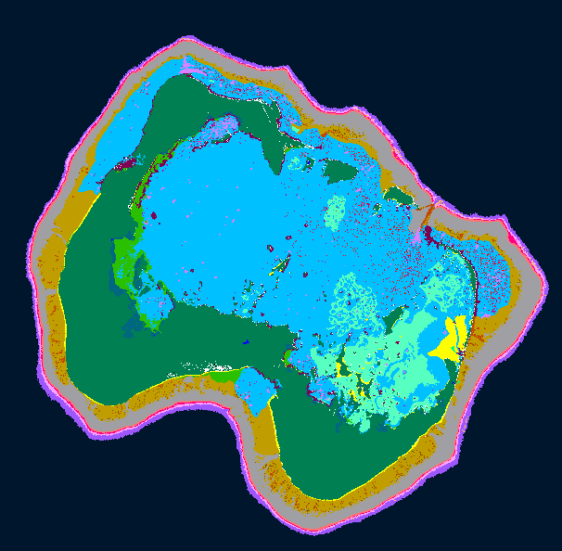
Image Processing for Coral Reef Dissimilarity
Analyzing images for coral reef diversity
Important for prioritizing interventions
Algorithm implemented productively
Add up weighted values of all points in a neighborhood, i.e., convolution over image
Developed by Scott Bachman, NCAR scientist who is a visiting scholar on the Chapel team
Scott started learning Chapel in Sept 2022, started Coral Reef app in Dec 2022, already had collaborators presenting results in Feb 2023
Last week with ~5 lines changed, ran on a GPU
Performance
Less than 300 lines of Chapel code scales out to 100s of processors on Cheyenne (NCAR)
Full maps calculated in seconds, rather than days
Notes:
Cheyenne is a large NCAR machine in Cheyenne, WY.

Slide 62
Distributed Parallelism: Divide the domain into “strips” and allocate a task per strip
Task 1
Task 2
…
Task (n-1)
Task n

Slide 63
Image Processing Example
cd image_analysis
make run-main
See 'image_analysis/' subdirectory in the Chapel examples
Coral reef diversity analysis written by Scott Bachman
Reads a single file in parallel
Uses distributed and shared memory parallelism
Is being used and modified by Scott and collaborators for climate research
'image_analysis/README' explains how to compile and run it
Concepts illustrated
User-defined modules
Sparse domains used to create masks in 'distance_mask.chpl'
Creating a 1D block distribution by reshaping the 'Locales' array
Gets to locale 0 will occur for some smaller arrays that live on locale 0
Notes:
I don't think Scott's image analysis is having to insert any puts and gets, but I am not entirely sure, https://github.com/chapel-lang/chapel/blob/main/test/users/bachman/Beta_Diversity
think it has some gets from Locale0
From Ben H, "I think there are two relevant arrays here: the array representing image data, and the "dissimilarity" array.I believe each locale reads into the local image chunk on its own: https://github.com/chapel-lang/chapel/blob/main/test/users/bachman/Beta_Diversity/main.chpl#L168-L189 , so there shouldn't be any GETs there. Furthermore, this section uses IO functionality that starts reading from a particular point in the file.It looks like the code is loading the dissimilarity array on Locale0 and then copying it to each locale before running the computation: https://github.com/chapel-lang/chapel/blob/main/test/users/bachman/Beta_Diversity/main.chpl#L195-L196 , so that would be a source of GETs (should be a bulk-transfer though).After that, I think everything's local."

Slide 64
GPU Support in Chapel
gpuExample.chpl
Generate code for GPUs
Support for NVIDIA and AMD GPUs
Exploring Intel support
Chapel code calling CUDA examples
https://github.com/chapel-lang/chapel/blob/main/test/gpu/interop/stream/streamChpl.chpl
https://github.com/chapel-lang/chapel/blob/main/test/gpu/interop/cuBLAS/cuBLAS.chpl
Key concepts
Using the 'locale' concept to indicate execution and data allocation on GPUs
'forall' and 'foreach' loops are converted to kernels
Arrays declared within GPU sublocale code blocks are allocated on the GPU
For more info...
https://chapel-lang.org/docs/technotes/gpu.html
use GpuDiagnostics;
startGpuDiagnostics();
var operateOn =
if here.gpus.size>0 then here.gpus
else [here,];
// Same code can run on GPU or CPU
coforall loc in operateOn do on loc {
var A : [1..10] int;
foreach a in A do a+=1;
writeln(A);
}
stopGpuDiagnostics();
writeln(getGpuDiagnostics());

Slide 65
Stream Triad: Distributed Memory, GPUs AND CPUS
stream-ep.chpl
config var n = 1_000_000,
alpha = 0.01;
coforall loc in Locales do on loc {
cobegin {
coforall gpu in here.gpus do on gpu {
var A, B, C: [1..n] real;
A = B + alpha * C;
}
{
var A, B, C: [1..n] real;
A = B + alpha * C;
}
}
}
}
‘cobegin { … }’ creates a task per child statement
one task runs our multi-GPU triad
the other runs the multi-CPU triad
This program uses all CPUs and GPUs across all of your compute nodes

Slide 66
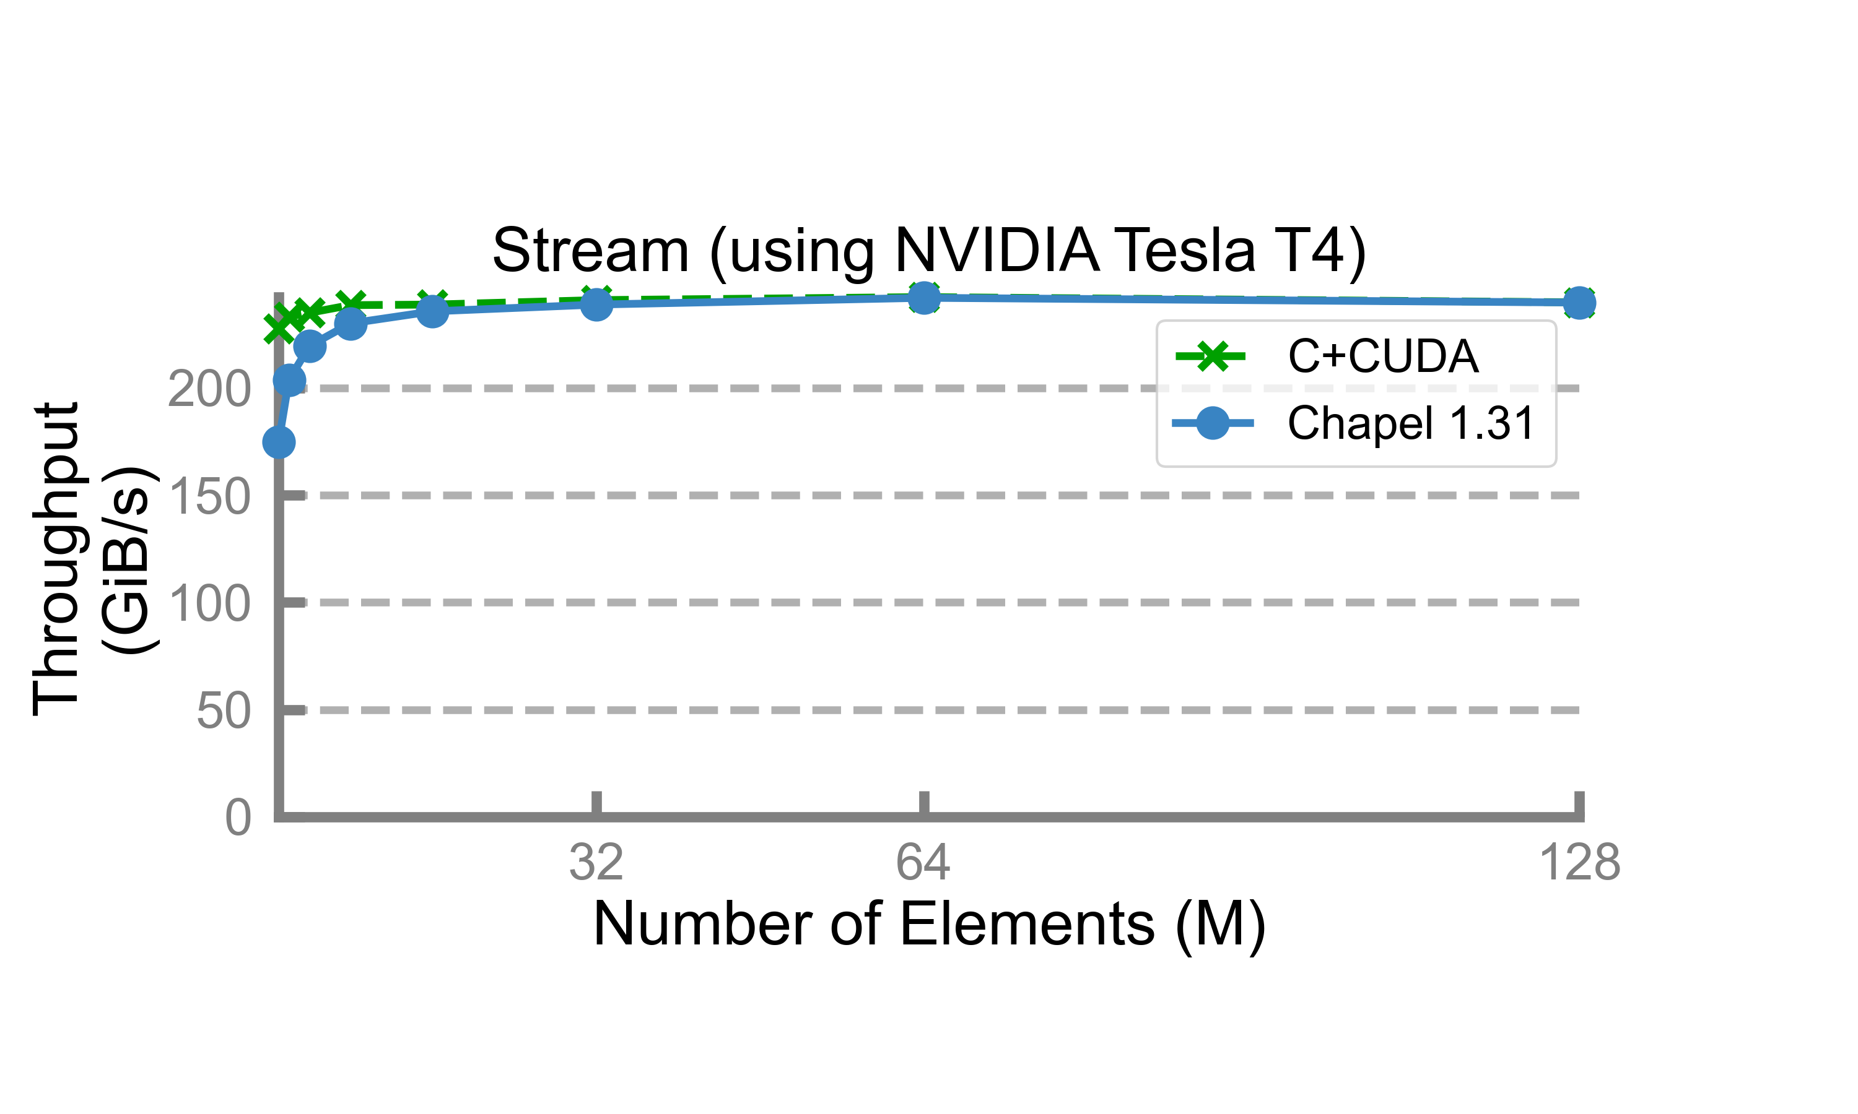
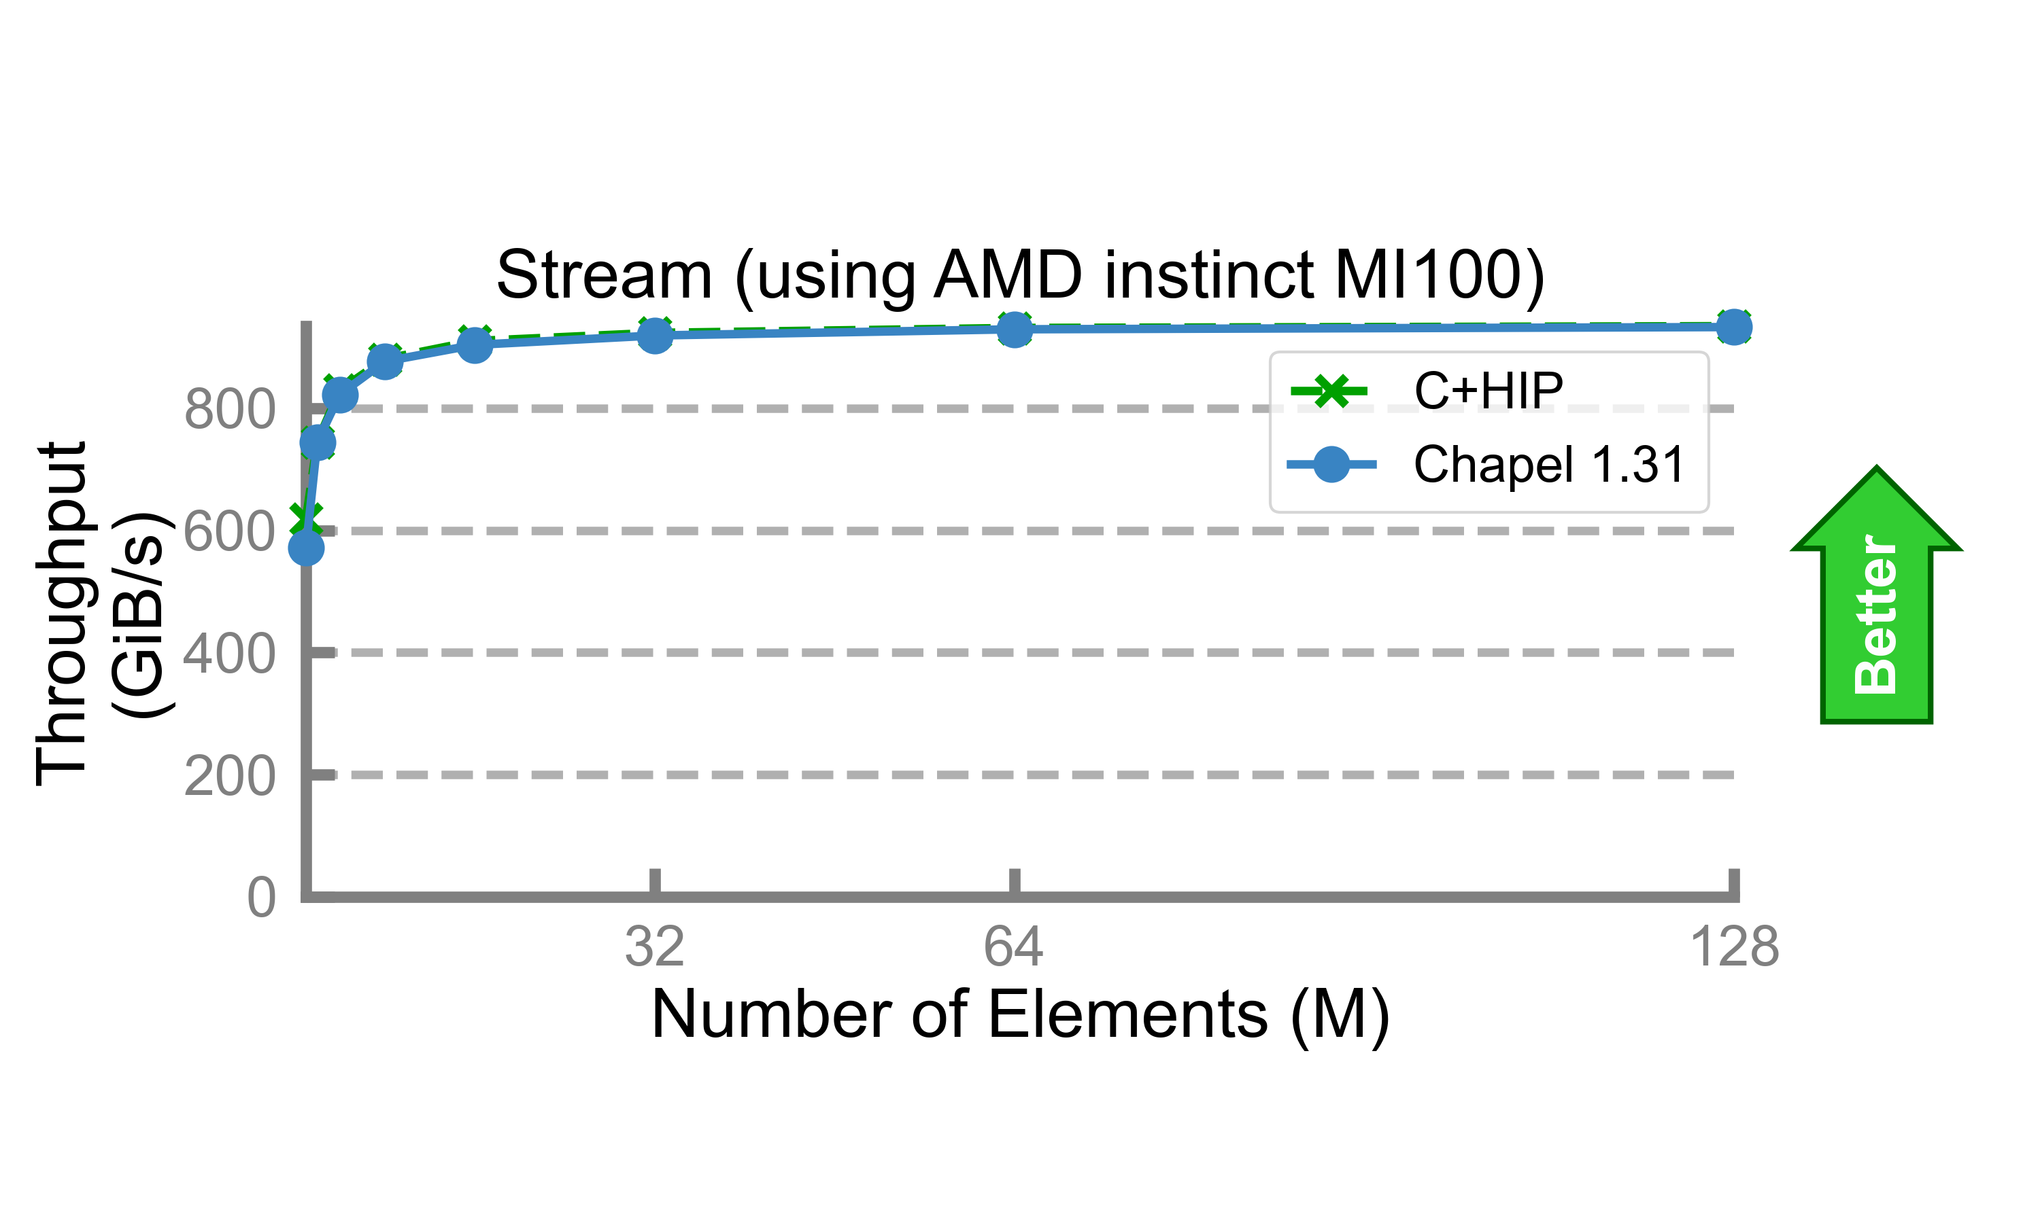
Stream Triad: Performance vs. Reference versions
Performance vs. reference versions has become increasingly competitive over the past 6 months
Notes:
From Andy's message in slack, https://cray.slack.com/archives/C024Q0N3M5Y/p1688160430709409

Slide 67
Key Concerns for scalable Parallel Computing
parallelism: What tasks should run simultaneously?
locality: Where should tasks run? Where should data be allocated?
complicating matters, compute nodes now often have GPUs with their own processors and memory
Locale 0
Locale 1
Locale 2
Locale 3
Processor Core
Memory
Notes:
From ChapelForCTO Brad talk from 2023.

Slide 68
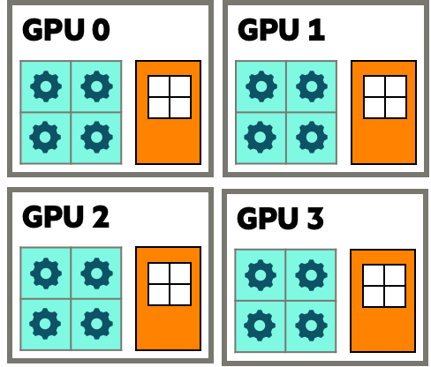
Key Concerns for scalable Parallel Computing
parallelism: What tasks should run simultaneously?
locality: Where should tasks run? Where should data be allocated?
complicating matters, compute nodes now often have GPUs with their own processors and memory
we represent these as sub-locales in Chapel
Locale 0
Locale 1
Locale 2
Locale 3
Processor Core
Memory

Slide 69
Stream Triad Using GPUs AND CPUS (Single-locale)
stream-ep.chpl
config const n = 1_000_000,
alpha = 0.01;
cobegin {
coforall gpu in here.gpus do on gpu {
var A, B, C: [1..n] real;
A = B + alpha * C;
}
{
var A, B, C: [1..n] real;
A = B + alpha * C;
}
}
Improved syntax for GPU sublocales
This program uses all CPUs and GPUs on a single compute node

Slide 70
Stream Triad Using GPUs AND CPUS (multi-locale)
stream-ep.chpl
config const n = 1_000_000,
alpha = 0.01;
coforall loc in Locales do on loc {
cobegin {
coforall gpu in here.gpus do on gpu {
var A, B, C: [1..n] real;
A = B + alpha * C;
}
{
var A, B, C: [1..n] real;
A = B + alpha * C;
}
}
}
Support for multi-locale GPU programs
This program uses all CPUs and GPUs across all of our compute nodes

Slide 71
Stream Triad: Distributed Memory, CPUs Only
stream-glbl.chpl
config const n = 1_000_000,
alpha = 0.01;
use BlockDist;
const Dom = Block.createDomain({1..n});
var A, B, C: [Dom] real;
A = B + alpha * C;
stream-ep.chpl
config const n = 1_000_000,
alpha = 0.01;
coforall loc in Locales {
on loc {
var A, B, C: [1..n] real;
A = B + alpha * C;
}
}
These programs are both CPU-only
Nothing refers to GPUs, explicitly or implicitly

Slide 72
Stream Triad: Distributed Memory, GPUs only
stream-ep.chpl
config const n = 1_000_000,
alpha = 0.01;
coforall loc in Locales do on loc {
coforall gpu in here.gpus do on gpu {
var A, B, C: [1..n] real;
A = B + alpha * C;
}
}
Use a similar ‘coforall’ + ‘on’ idiom to run a Triad concurrently on each of this locale’s GPUs
This is a GPU-only program
Nothing other than coordination code runs on the CPUs

Slide 73
Stream Triad: Distributed Memory, GPUs AND CPUS
stream-ep.chpl
‘cobegin { … }’ creates a task per child statement
config const n = 1_000_000,
alpha = 0.01;
coforall loc in Locales do on loc {
cobegin {
coforall gpu in here.gpus do on gpu {
var A, B, C: [1..n] real;
A = B + alpha * C;
}
{
var A, B, C: [1..n] real;
A = B + alpha * C;
}
}
}
one task runs our multi-GPU triad
the other runs the multi-CPU triad
This program uses all CPUs and GPUs across all of our compute nodes

Slide 74
Other Chapel Examples & Presentations
Primers
https://chapel-lang.org/docs/primers/index.html
Blog posts for Advent of Code
https://chapel-lang.org/blog/index.html
Test directory in main repository
https://github.com/chapel-lang/chapel/tree/main/test
Presentations
https://chapel-lang.org/presentations.html

Slide 75
Tutorial Summary
Takeaways
Chapel is a PGAS programming language designed to leverage parallelism
It is being used in some large production codes
Our team is responsive to user questions and would enjoy having you participate in our community
How to get more help
Ask the Chapel team and users questions on discourse, gitter, or stack overflow
Also feel free to email me at michelle.strout@hpe.com
Engaging with the community
Share your sample codes with us and your research community!
Join us at our free, virtual workshop in June, https://chapel-lang.org/CHIUW.html

Slide 76
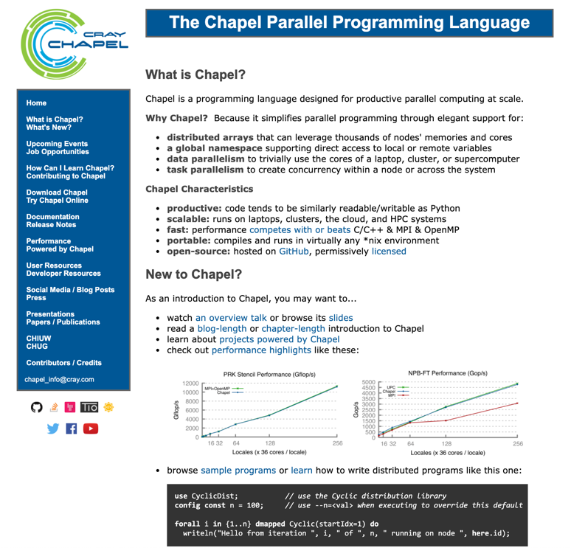
Chapel Resources
Chapel homepage: https://chapel-lang.org
(points to all other resources)
Social Media:
Twitter: @ChapelLanguage
Facebook: @ChapelLanguage
YouTube: http://www.youtube.com/c/ChapelParallelProgrammingLanguage
Community Discussion / Support:
Discourse: https://chapel.discourse.group/
Gitter: https://gitter.im/chapel-lang/chapel
Stack Overflow: https://stackoverflow.com/questions/tagged/chapel
GitHub Issues: https://github.com/chapel-lang/chapel/issues

Slide 77
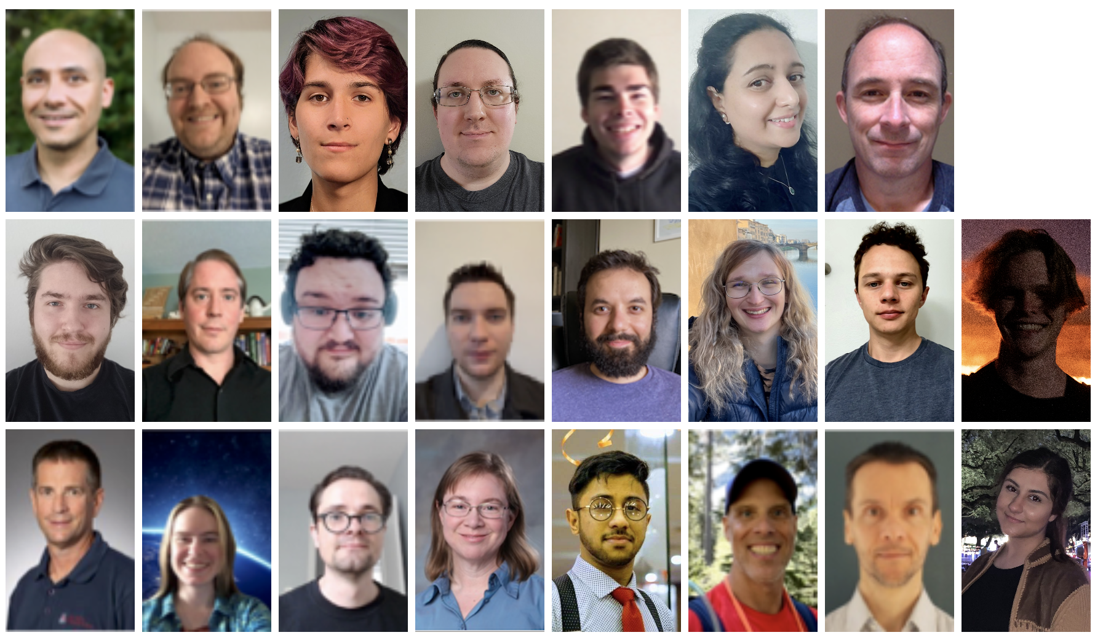
Current Chapel Team at HPE
HPE Proprietary
Notes:
Copied from Brad’s CHIUW 2021 SOP talk. Going to update for MS17.

Slide 78
Backup Slides and Additional Content

Slide 79
General Tips When Getting Started with Chapel (also in README)
Online documentation is here: https://chapel-lang.org/docs/
The primers can be particularly valuable for learning a concept: https://chapel-lang.org/docs/primers/index.html
These are also available from a Chapel release in ‘$CHPL_HOME/examples/primers/’
or ‘$CHPL_HOME/test/release/examples/primers/’ if you clone from GitHub
When debugging, almost anything in Chapel can be printed out with ‘writeln(expr1, expr2, expr3);’
Types can be printed after being cast to strings, e.g. ‘writeln(”Type of “, expr, “ is “, expr.type:string);’
A quick way to print a bunch of values out clearly is to print a tuple made up of them ‘writeln((x, y, z));’
Once your code is correct, before doing any performance timings, be sure to re-compile with ‘--fast’
Turns on optimizations, turns off safety checks, slows down compilation, speeds up execution significantly
Then, when you go back to making modifications, be sure to stop using `--fast` in order to turn checks back on
For vim / emacs users, syntax highlighters are in $CHPL_HOME/highlight
Imperfect, but typically better than nothing
Emacs MELPA users may want to use the chapel-mode available there (better in many ways, weird in others)
Notes:
From Brad ChapelForOokamiUsers talk.

Slide 80
Other Task Parallel Features
begin / cobegin statements: the two other ways of creating tasks
atomic / synchronized variables: types for safe data sharing & coordination between tasks
task intents / task-private variables: control how variables and tasks relate
begin stmt; // fire off an asynchronous task to run ‘stmt’
cobegin { // fire off a task for each of ‘stmt1’, ‘stmt2’, …
stmt1;
stmt2;
stmt3;
…
} // wait here for these tasks to complete before proceeding
var sum: atomic int; // supports various atomic methods like .add(), .compareExchange(), …
var cursor: sync int; // stores a full/empty bit governing reads/writes, supporting .readEF(), .writeEF()
coforall i in 1..niters with (ref x, + reduce y, var z: int) { … }
Notes:
From Brad ChapelForOokamiUsers talk.

Slide 81
Spectrum of Chapel for-Loop Styles
for loop: each iteration is executed serially by the current task
predictable execution order, similar to conventional languages
foreach loop: all iterations executed by the current task, but in no specific order
a candidate for vectorization, SIMD execution on GPUs
forall loop: all iterations are executed by one or more tasks in no specific order
implemented using one or more tasks, locally or distributed, as determined by the iterand expression
coforall loop: each iteration is executed concurrently by a distinct task
explicit parallelism; supports synchronization between iterations (tasks)
forall i in 1..n do … // forall loops over ranges use local tasks only
forall (i,j) in {1..n, 1..n} do … // ditto for local domains…
forall elem in myLocArr do … // …and local arrays
forall elem in myDistArr do … // distributed arrays use tasks on each locale owning part of the array
forall i in myParIter(…) do … // you can also write your own iterators that use the policy you want
Notes:
From Brad ChapelForOokamiUsers talk.
FIXME: could add a pointer to the new primer on loops.

Slide 82
SideBar: Promotion Of Scalar Subroutines
Any function or operator that takes scalar arguments can be called with array expressions instead
Interpretation is similar to that of a zippered forall loop, thus:
is equivalent to:
as is:
So, in the Jacobi computation,
==
proc foo(x: real, y: real, z: real) {
return x**y + 10*c;
}
C = foo(A, 2, B);
forall (c, a, b) in zip(C, A, B) do
c = foo(a, 2, b);
C = A**2 + 10*c;
abs(A[D] - Temp[D]);
forall (a,t) in zip(A[D], Temp[D]) do abs(a – t);
Notes:
From Brad ChapelForOokamiUsers talk.

